Slide 1

Customer Churn Prediction Analysis
Richard Jackson

Slide 2

Introduction
Customer churn is a problem faced by every business, particularly those who are subscription-based services.
CAC or the cost to acquire a new customer is sometimes considerably more to keep a current customer.
Businesses need to know who is likely to cancel and take steps to try and keep those customers.
Customer churn prediction is useful in helping businesses direct the appropriate efforts towards those customers most likely to churn.

Slide 3

Methodology
Utilize features of customers both current and churned to determine which aspects of customer behavior are determinative of likelihood of cancellation of service.
Customer churn analysis using
Logistic Regression
Random Forest model

Slide 4
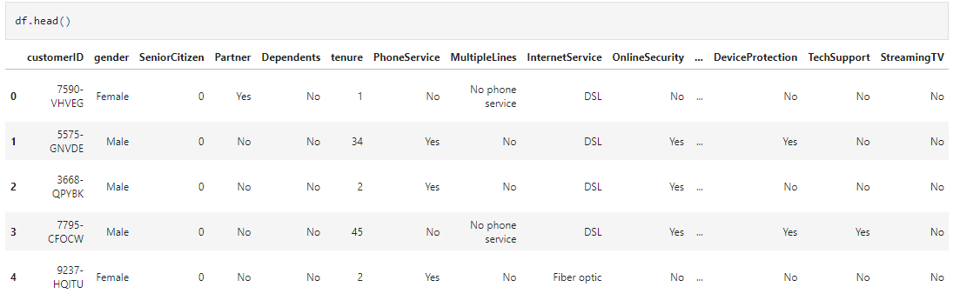
Data
Retrieved from IBM
Has 7043 customers – 5174 current and 1869 churned
Has 21 features and over 7043 rows

Slide 5
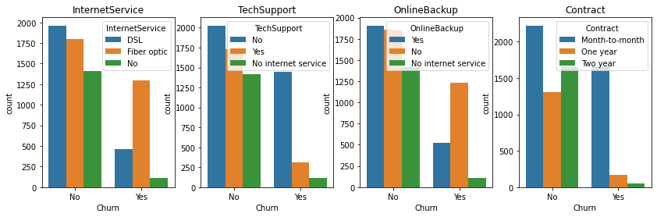
Exploratory Data Analysis
Customers with no online security or backup, no device protection, and no tech support are from two to three times more likely to churn.
Customers with no internet service are unlikely to churn.
Customers with month-to-month contracts are almost four times more likely to churn than customers with yearly contracts. Two-year contractors are very unlikely to churn.

Slide 6
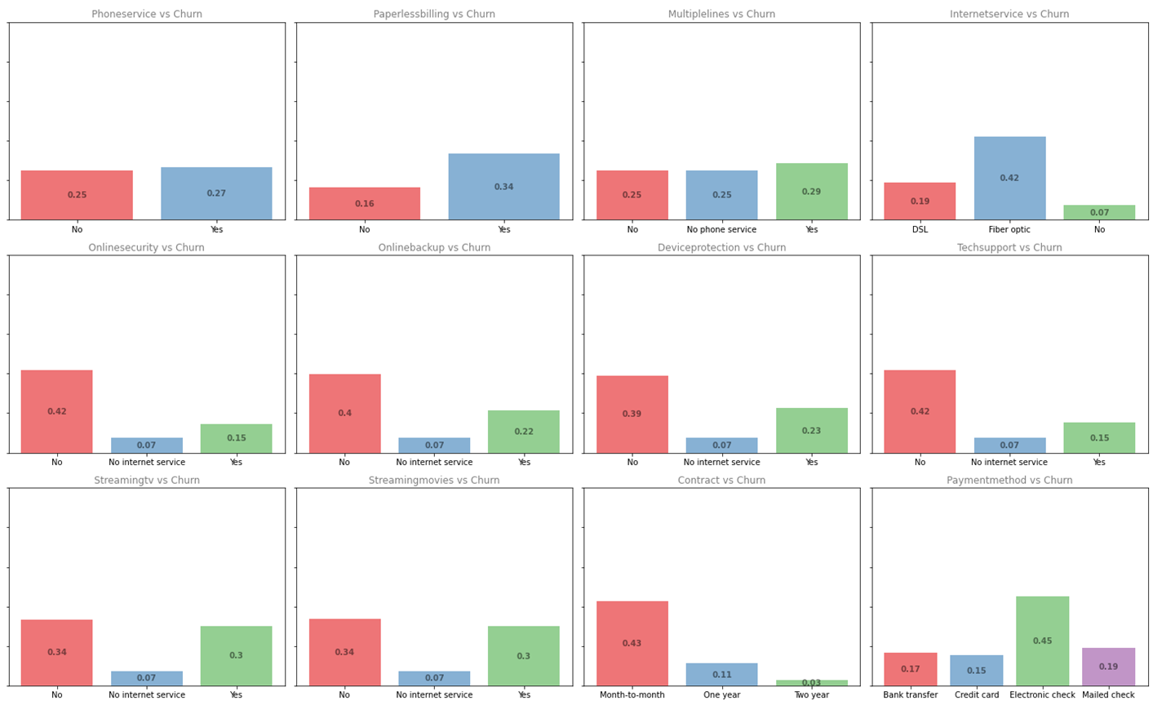
Exploratory Data Analysis
Customers without dependents are two times more likely to churn.
Customers that use paperless billing and optical fiber are more likely to churn.
Customers that use electronic checks to pay their bills are more likely to churn.

Slide 7
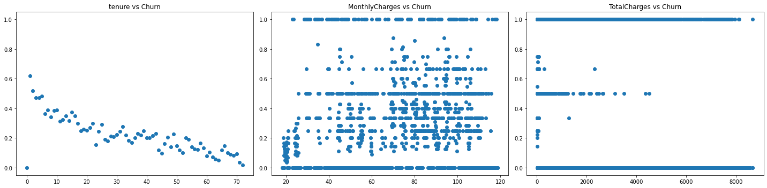
Correlations
There is a direct correlation between Tenure and Churn

Slide 8
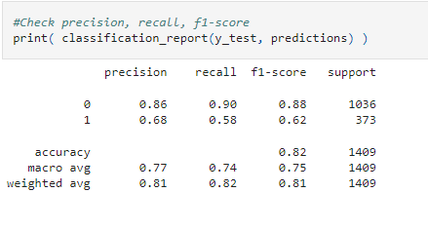
Machine Learning Models
I first tried a Logistic Regression model using Scikit-Learn
The recall of this model is ≈ 90% which means it correctly identified 90% of the customers which were retained. The precision was ≈ 86% and the f1 score was 88%. The accuracy of this model is about 82%.

Slide 9
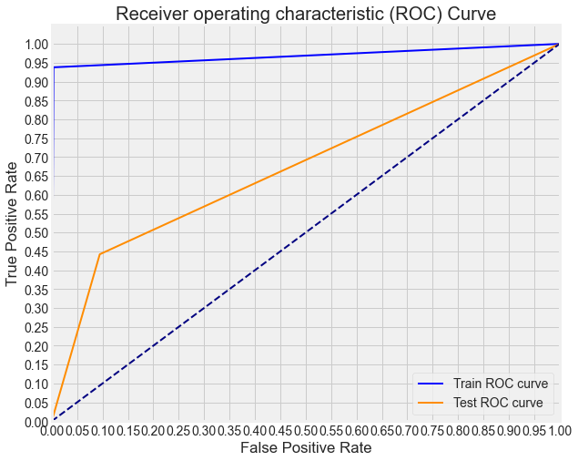
Random Forest model
I then created a random forest model
This model had slightly better recall than Logistic regression at 91% but had less precision and less accuracy than Logistic regression model.

Slide 10
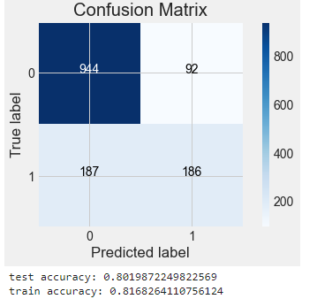
Hyperparameter tuning the model
I used Scikit-Learns Grid Search CV to find the optimum number of trees for the random forest model
It did have a slight increase on the model’s accuracy

Slide 11

Results
Even though hypertuning increased the Random Forest Model slighlty, the logistic regression model still perfomed better and is the model that I would use

Slide 12

Future Improvements
Add XGBoost Model
Utilize techniques to combat the fact that this is an unbalanced data set.

